Slide 1
IT1212 System Analysis & Design
System Design

Slide 2

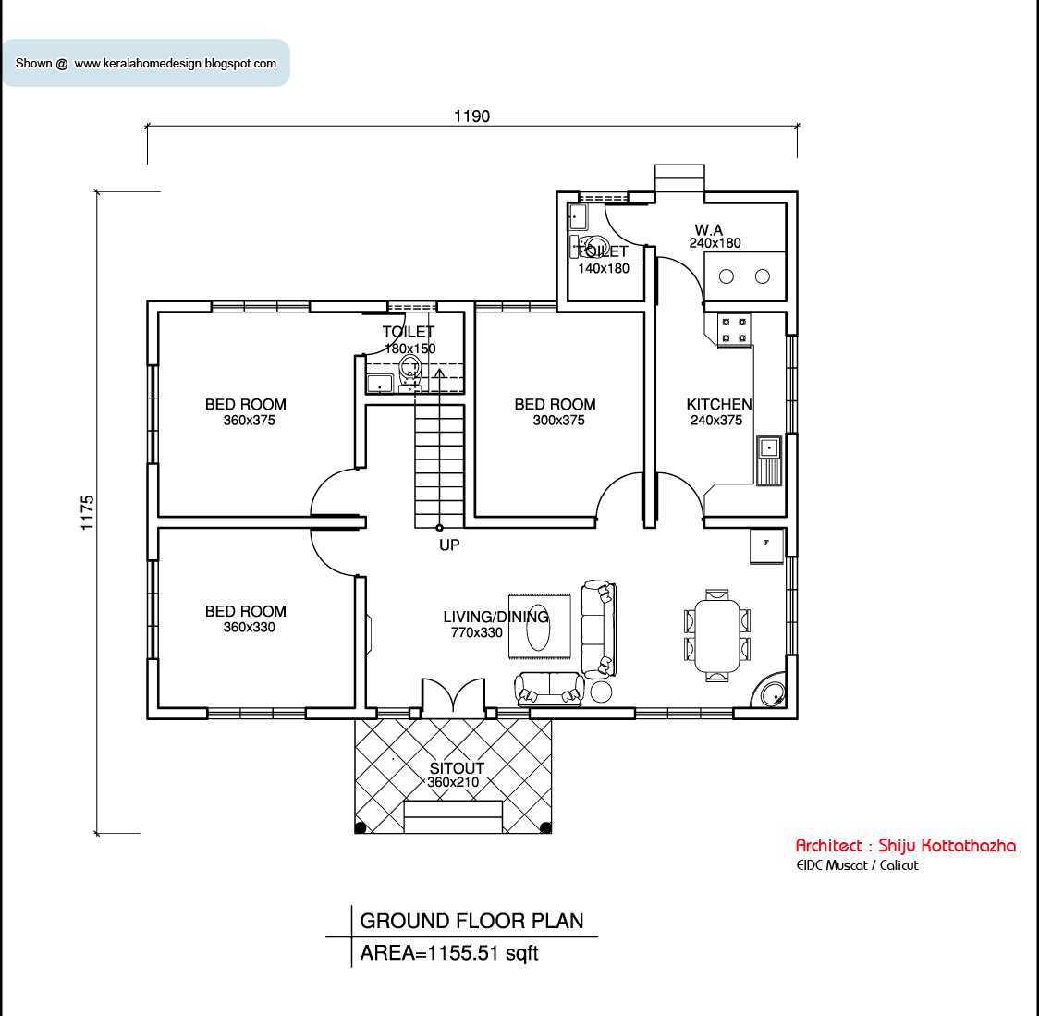
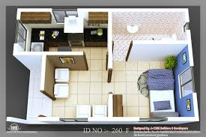
Model
Model is a presentation of reality.
Just a picture is worth a thousand of words, most system models are pictorial representations of reality.

Slide 3
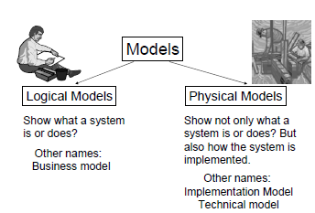

Slide 4
Modelling Methods A set of techniques used to implement a Methodology
• Data Flow Diagrams -
– A process model
– Depict the flow of data through a system and the work
performed by the system
• Entity Relationship Diagrams –
– A data model
– Depict data in terms of entities and relationships described by the data
– Consists of several notations
• Structure Charts etc.

Slide 5
Process Modeling
A technique for organizing and documenting the Process Requirements and Design for a system.
Data Flow Diagram :
A Popular Process Modeling Technique.
Shows the flow of data through the system and the processing performed by the system.

Slide 6
Process Modeling…
Systems Analyst may first draw
Data Flow Diagram OR
Documents Flow Diagram
Depends on the Methodology

Slide 7


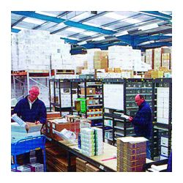
Document Flow Diagrams
Used to examine the flow of documents within the existing system.
Example: Purchasing System
Purch.
Dept.
Supplier
Order
Invoice
Delivery note
Delivery note
Stores

Slide 8
Document Flow Diagrams…
Used to identify physical movement of documents.
Purchase Order
Supplier
Purch.
Dept.
….
…..

Slide 9
Document Flow Diagrams…
Example: Purchasing System
Purch.
Dept.
Order
Supplier
Invoice
Stores
Delivery note
Delivery note
System boundary

Slide 10
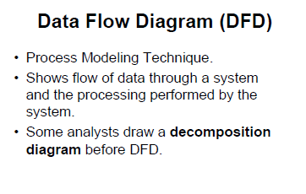

Slide 11
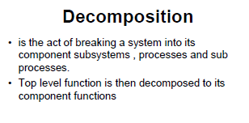

Slide 12
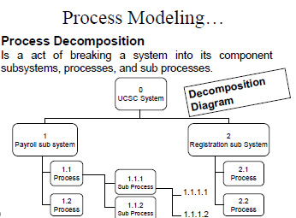
ATI System

Slide 13
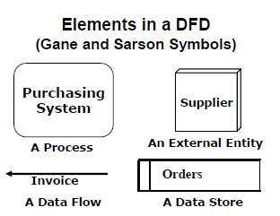

Slide 14
Data Flows
Data flow model the passage of data in the system and are represented by lines joining system components.
Flows of data in the system can take place:
Between two processes
From a data store to a process
From a process to a data store
From entities to a process
From process to a entities

Slide 15
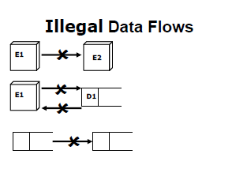

Slide 16
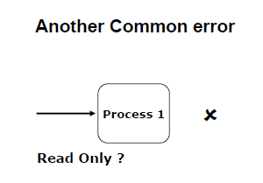

Slide 17
Context diagram
A common way to begin is to model, the whole system by one process.
It shows all the external entities that interact with the system and the data flow between these external entities and the system.

Slide 18
Context Diagram
defines the scope of the system by identifying the system boundary
contains:
one process (which represents the entire system)
all sources/sinks (external entities)
data flows linking the process to the sources and sinks (external entities)

Slide 19
Constructing a Context Diagram
identify and list sources/sinks (external entities)
identify and list inputs to and outputs from sources/sinks (external entities)
create context diagram

Slide 20
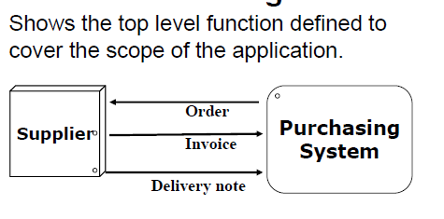

Slide 21
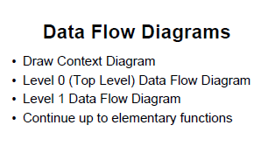

Slide 22
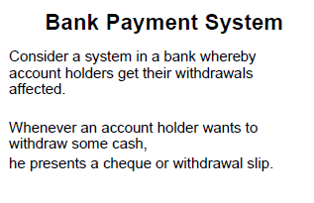

Slide 23
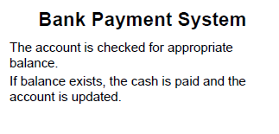

Slide 24
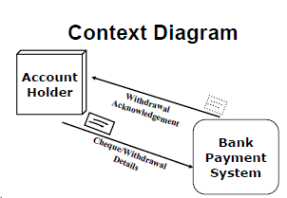

Slide 25
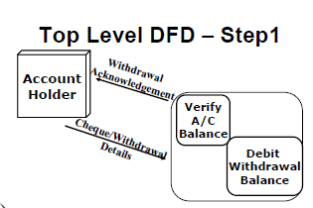

Slide 26
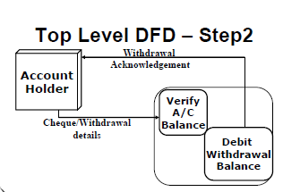

Slide 27
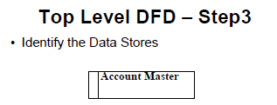

Slide 28
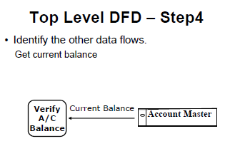

Slide 29
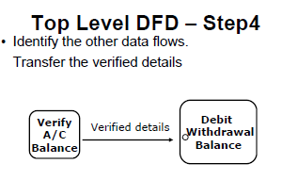

Slide 30
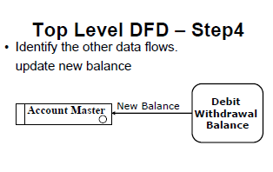

Slide 31
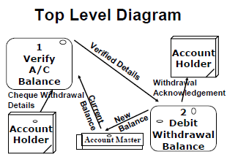

Slide 32
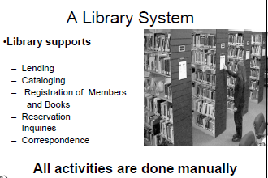

Slide 33
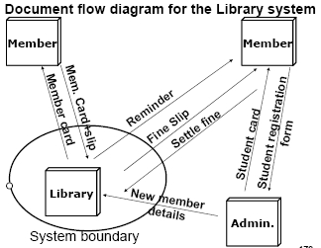
Library System

Slide 34
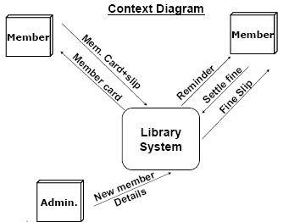

Slide 35
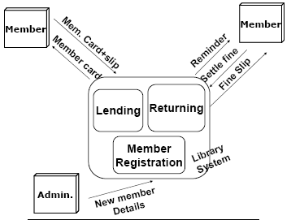

Slide 36
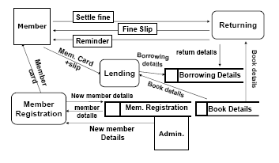

Slide 37
Level-0 Diagram
describes the overall processing of the system
show one process for each major processing step or functional requirement
can draw duplicate sources, sinks and data stores to increase legibility

Slide 38
Drawing a Level-0 Diagram
list the major data stores
list major business steps
draw a segment for each business step
assemble into single DFD
re-organize until satisfied
number processes

Slide 39
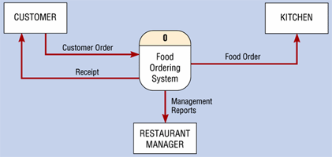
DFD context level diagram

Slide 40
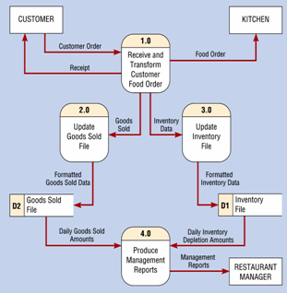
DFD level 0 diagram
Notes:
Decomposition

Slide 41
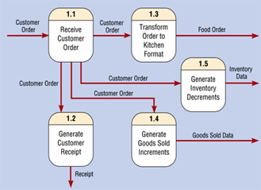
DFD level 1 diagram

Slide 42
Other Questions about Lower level diagrams
1. How deep? (how many levels?)
if the process has only one input or one output, probably cannot partition further;
can you describe the process in English in about 1/2 page?
2. How broad? (how many processes on a level?)
7 ± two is a reasonable
may temporarily place much of the system on a single diagram then re-draw into separate levels

Slide 43
Quality Guidelines
Completeness
all components included & in project dictionary
Consistency
between levels: balancing, leveling
Timing considerations
assume system never starts and never stops
Iterative nature
revisions are common
Drawing primitives (lowest level)
when to stop?

Slide 44
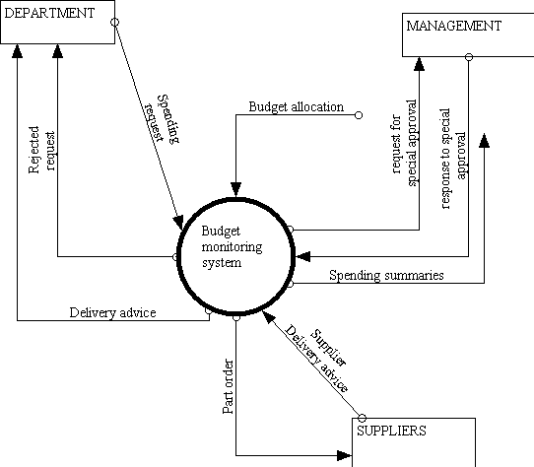
Budget monitoring system

Slide 45
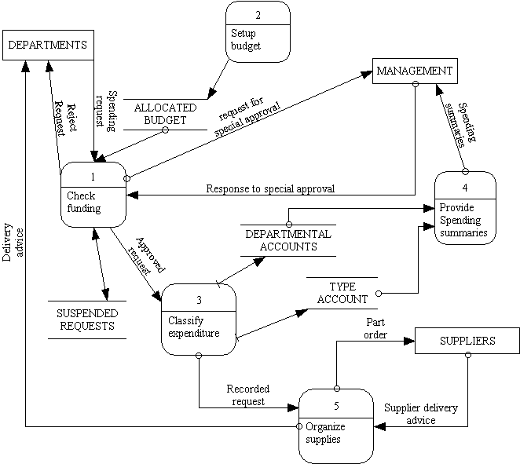
Top-level DFD diagram

Slide 46
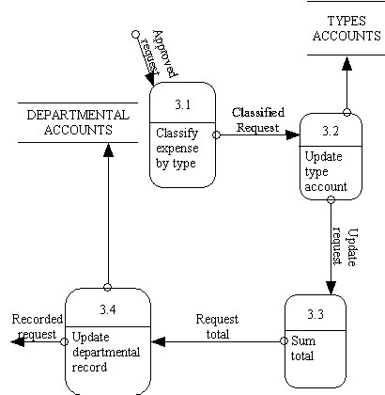
Expansion of classify expenditure process

Slide 47
DFD Example: Bus Garage Repairs
Buses come to a garage for repairs.
A mechanic and helper perform the repair, record the reason for the repair and record the total cost of all parts used on a Shop Repair Order.
Information on labor, parts and repair outcome is used for billing by the Accounting Department, parts monitoring by the inventory management computer system and a performance review by the supervisor.

Slide 48
DFD Example: Bus Garage Repairs (cont’d)
External Entities: Bus, Mechanic, Helper, Supervisor, Inventory Management System, Accounting Department, etc.
Key process (“the system”): performing repairs and storing information related to repairs
Processes:
Record Bus ID and reason for repair
Determine parts needed
Perform repair
Calculate parts extended and total cost
Record labor hours, cost

Slide 49
DFD Example: Bus Garage Repairs (cont’d)
Data stores:
Personal file
Repairs file
Bus master list
Parts list
Data flows:
Repair order
Bus record
Parts record
Employee timecard
Invoices

Slide 50
Bus Garage Context Diagram
Bus
Mechanical problem
to be repaired
Fixed mechanical
problems
Repair summary
Supervisor
Helper
Labor
Bus Repair Process
System
List of parts used
Inventory Management System
Labor
Labor, parts cost details
Mechanic
Accounting

Slide 51
What is a good data flow diagram?
The absence of flowchart structures
protection of data
Good naming conventions

Slide 52
Differences between flowcharts and data flow diagrams
DFDs are not program flow chats and should not include control elements. A good DFD should;
Have no data flows that split up into a number of other data flows.
Have no crossing lines
Not include flowchart loops of control elements
Not include data flows that act as signals to activate processes

